Slide 1
Object Detection and Classification using Deep Learning
Team Members: Pranshu Diwan
Sushma Suresh
Varun Jagadeesh

Slide 2


Introduction: Convolutional Neural Network
Complex Feed Forward Neural Network predominantly used to analyze images
Combination of multiple convolution layers linking to fully connected layer which generated the output
Convolution performed on an input data using a kernel to produce a feature map
The algorithms which we will be using are variants of CNN such as :
YOLO
MASK-RCNN
InceptionV3

Slide 3
Goal: detect and classify images to enable an autonomous VEHICLE VISION SYSTEM
Input images for Training
Training: Detection and Classification
Training: Classification
YOLO
Mask R-CNN
Inception-v3
Testing: Captured images of roads with multiple objects
Testing: Images of commonly found objects on the road
Classes of objects in the image
Probability of classification
Classes of image
Probability of classification

Slide 4
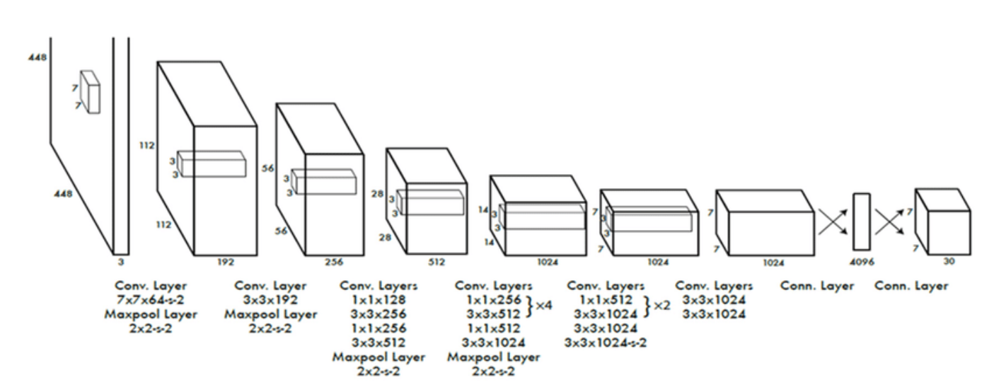
Technique 1: You only look once (Yolo)

Slide 5
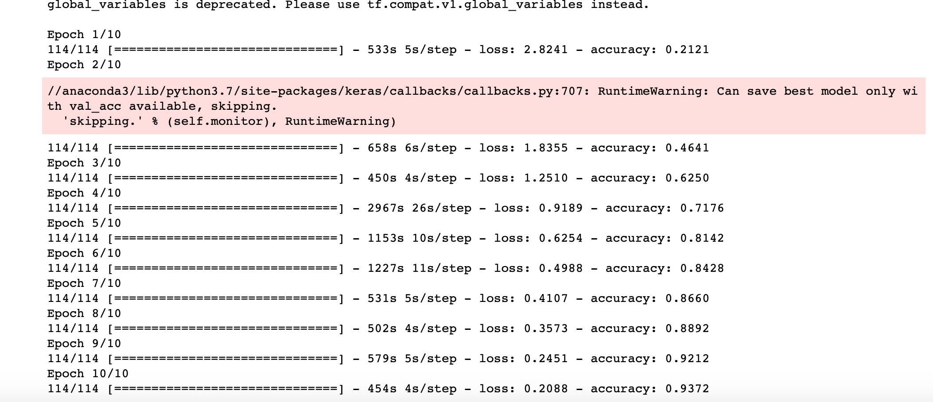
Implementation: TRAINING

Slide 6
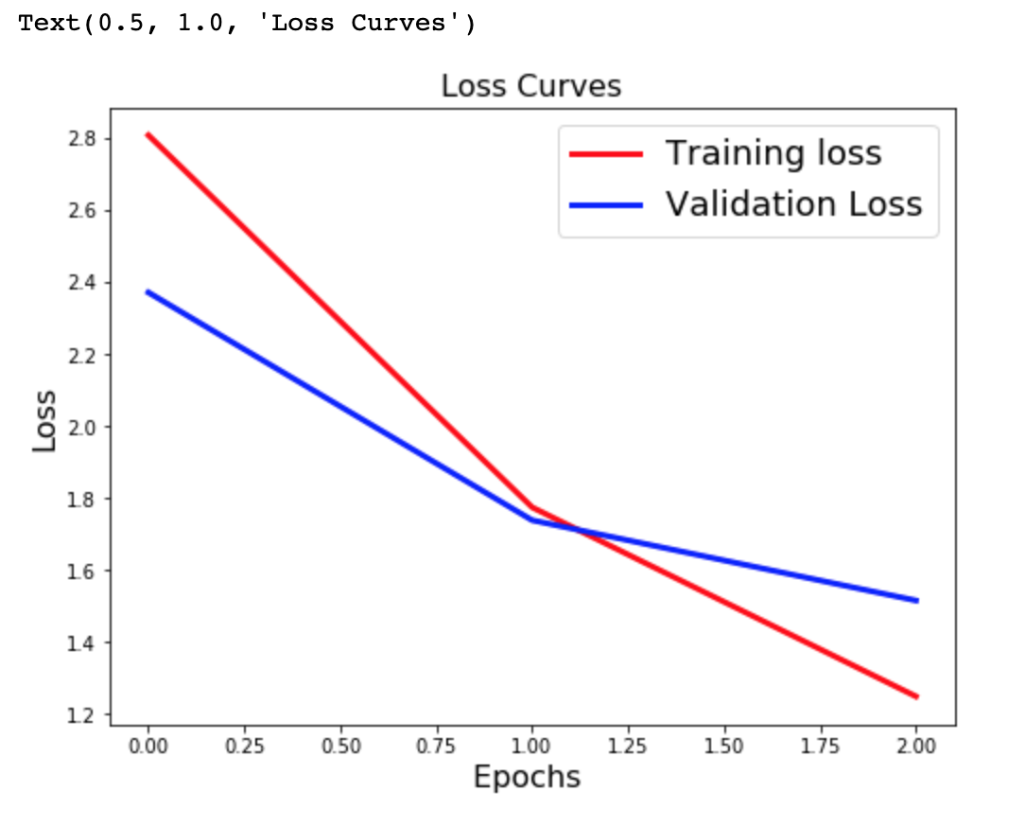
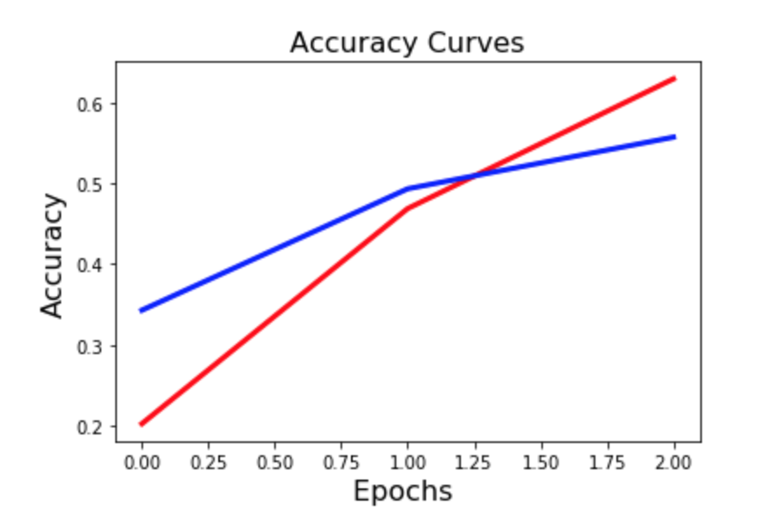
Implementation: Testing

Slide 7
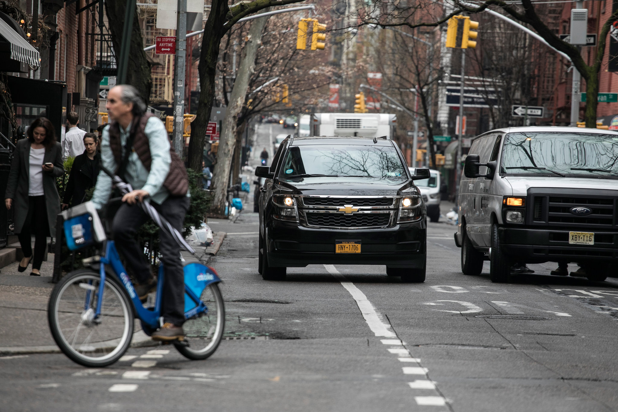
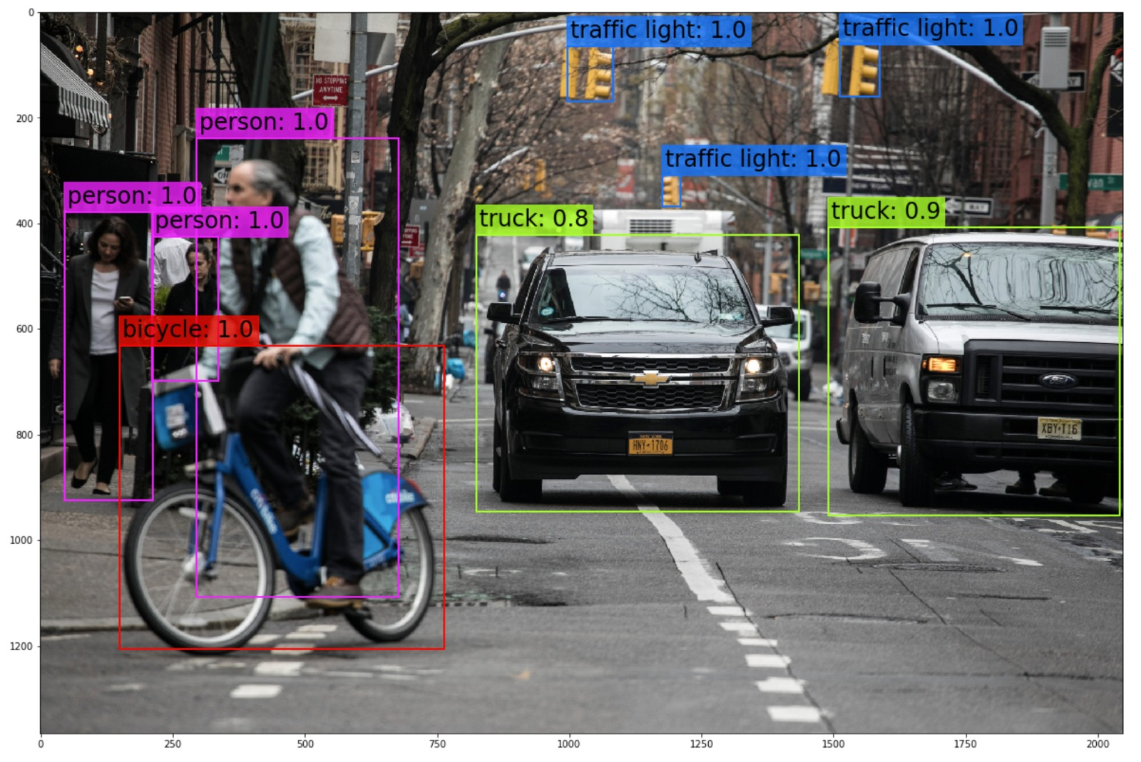
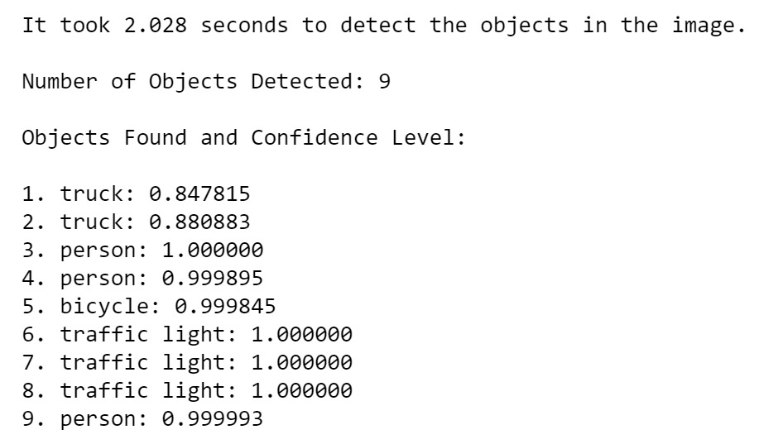
Results
Input Image
Output Image
Classification Statistics

Slide 8
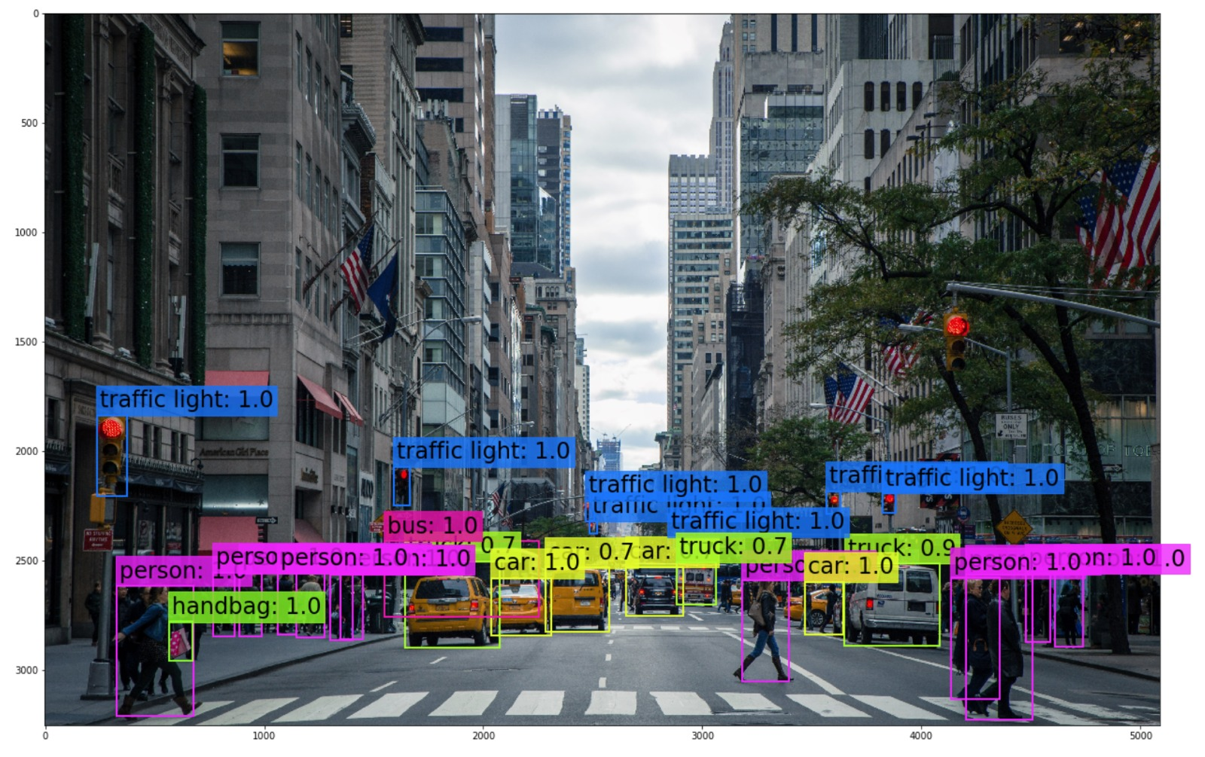


Slide 9
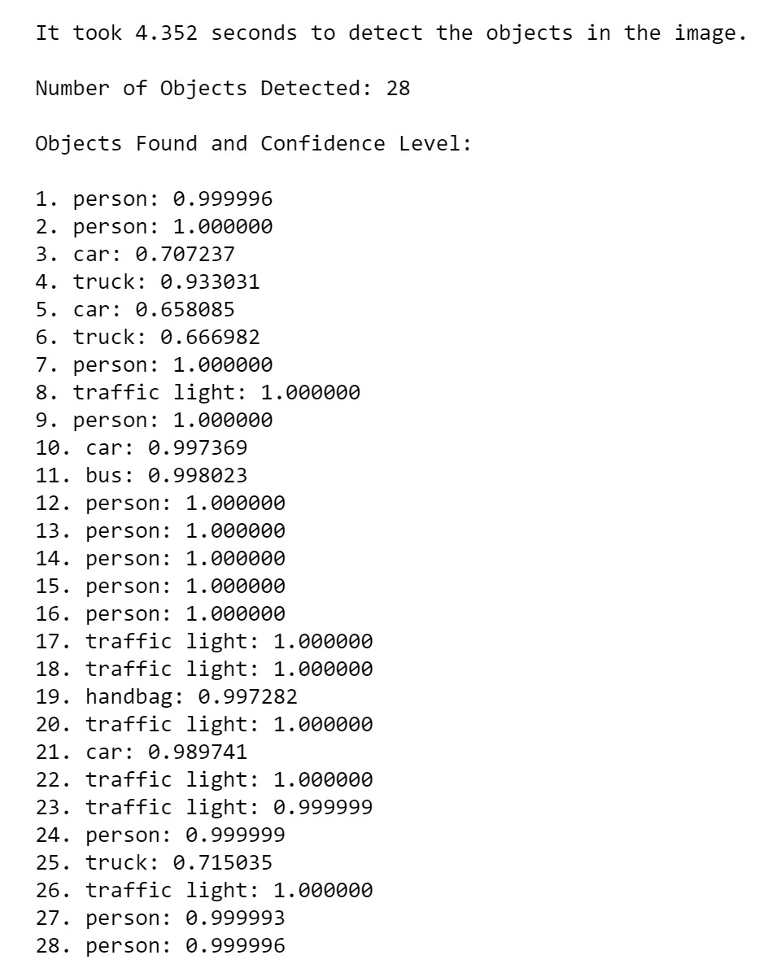

Slide 10
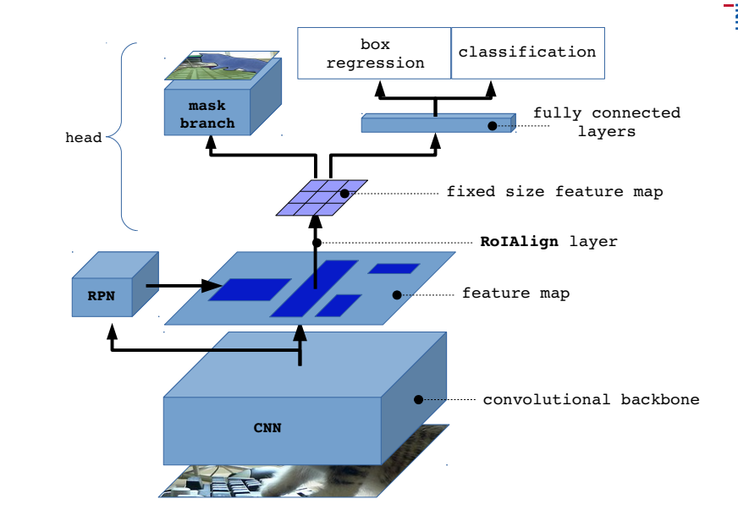
Technique 2: Mask-RCNN
What it is
Architecture and how it works
Difference between Yolo and Mask RCNN

Slide 11
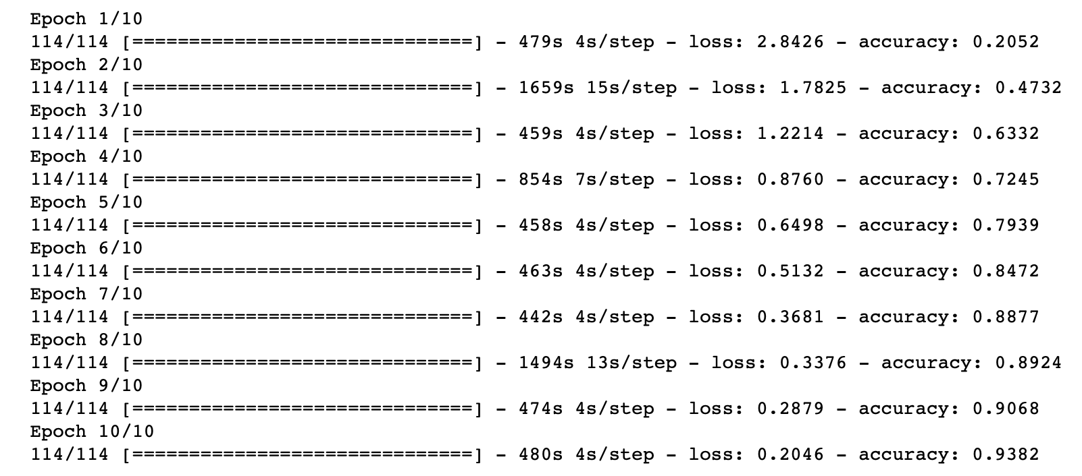
Implementation: training

Slide 12
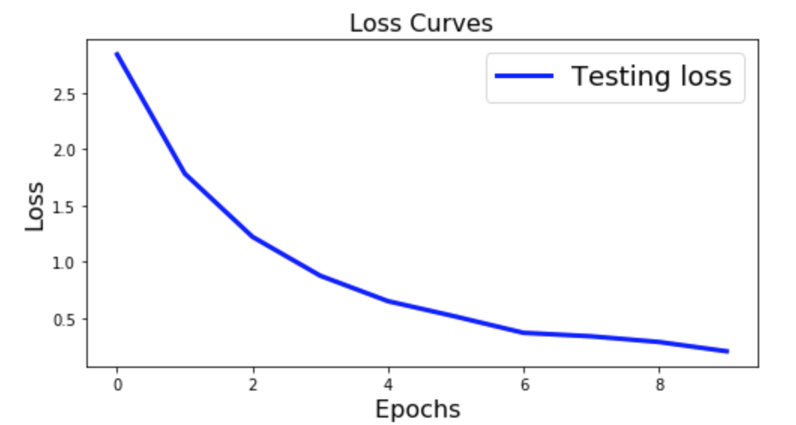
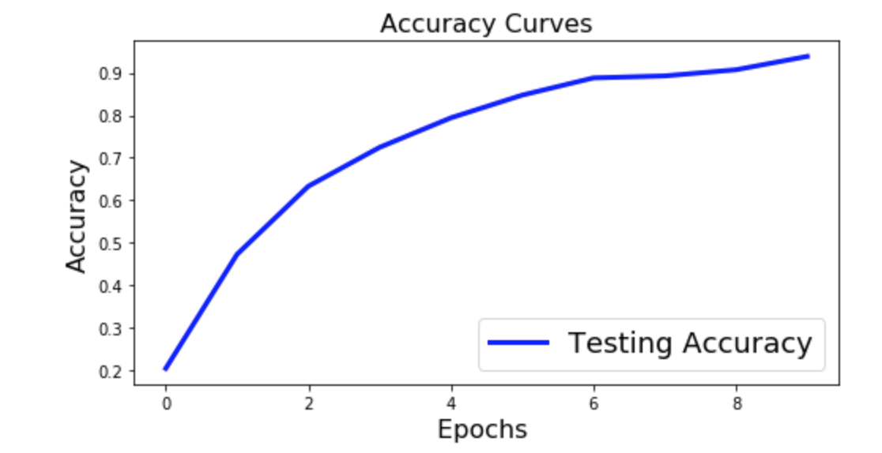
Implementation: Testing

Slide 13
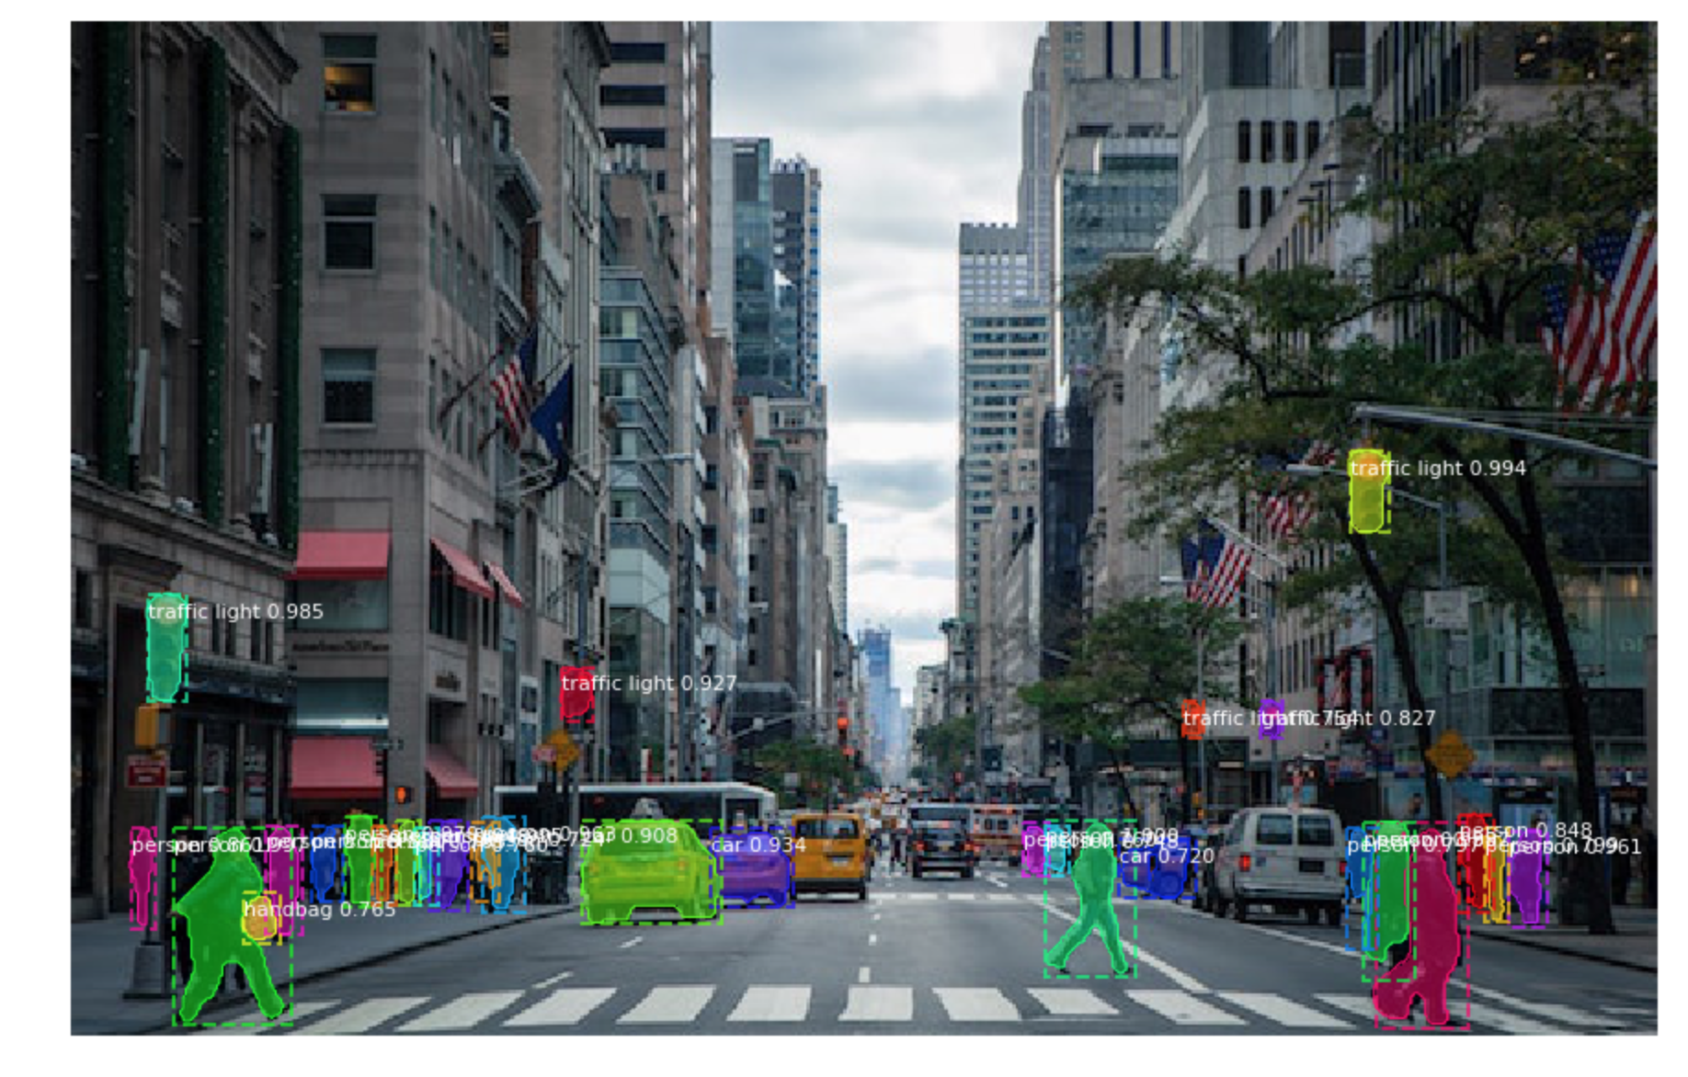
Results

Slide 14
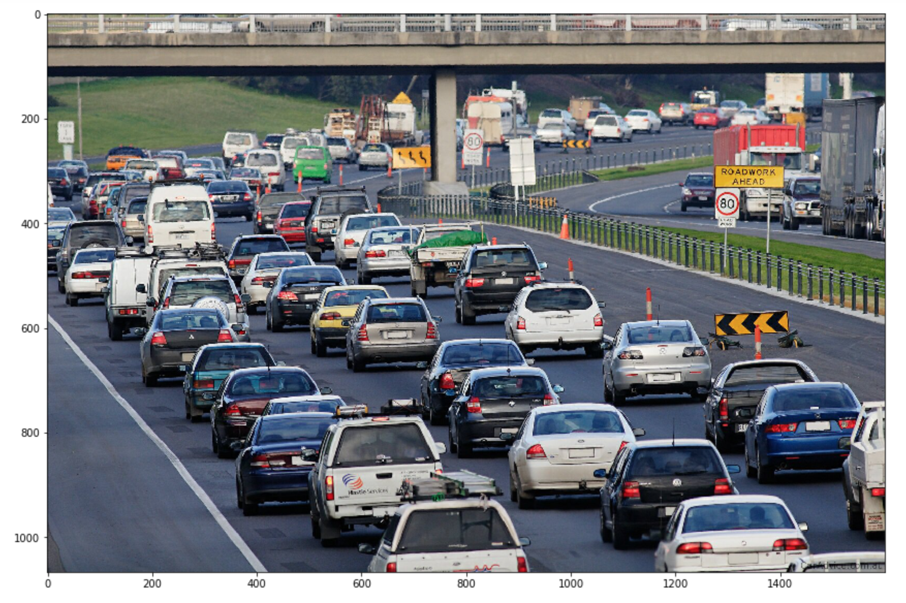
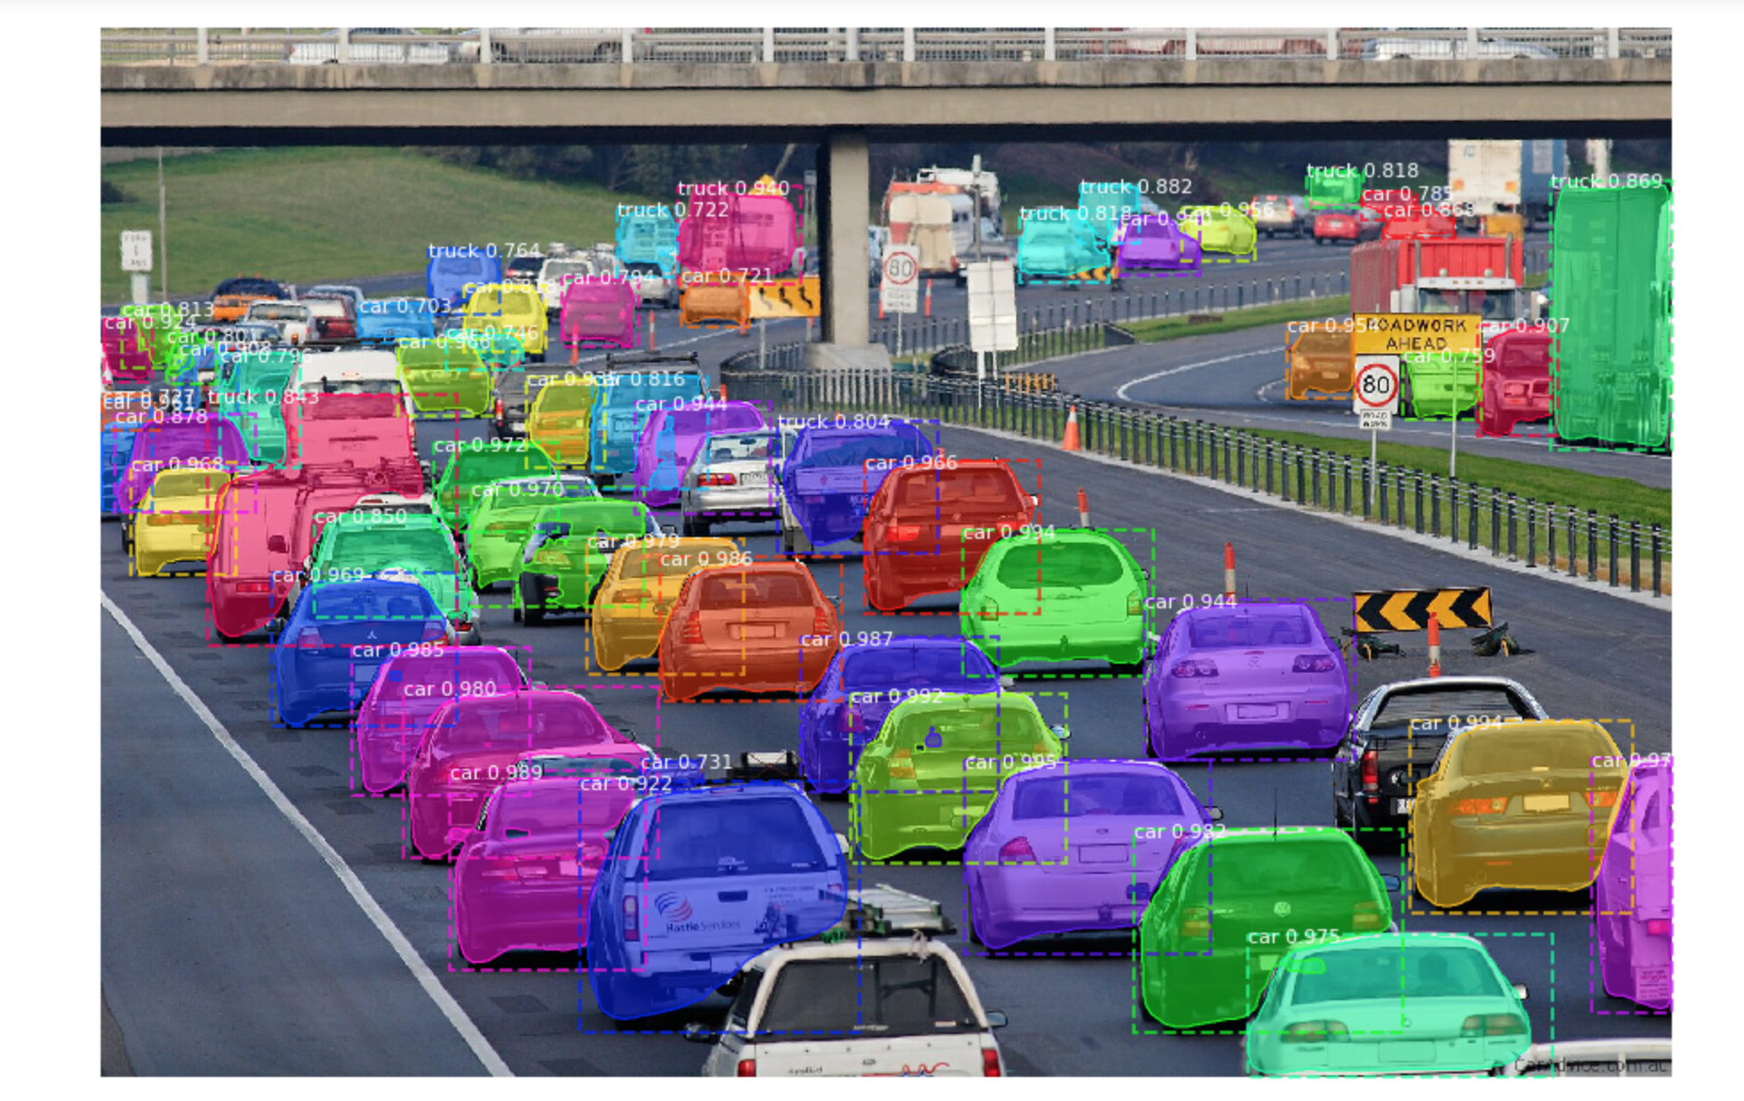
RESULTS

Slide 15
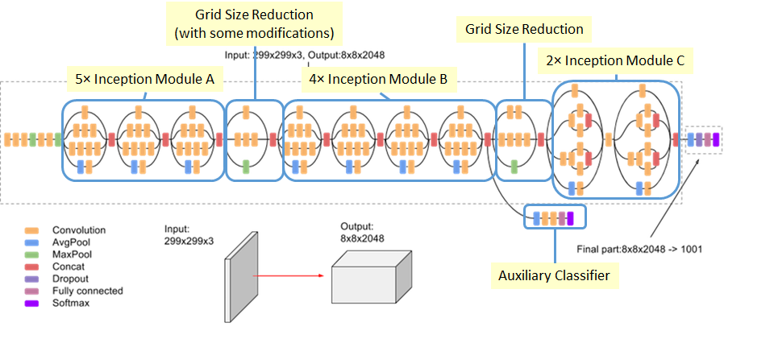
Technique 3: Inception-V3
What it is
How does it work
Training Dataset
How is it different from other algorithms?

Slide 16
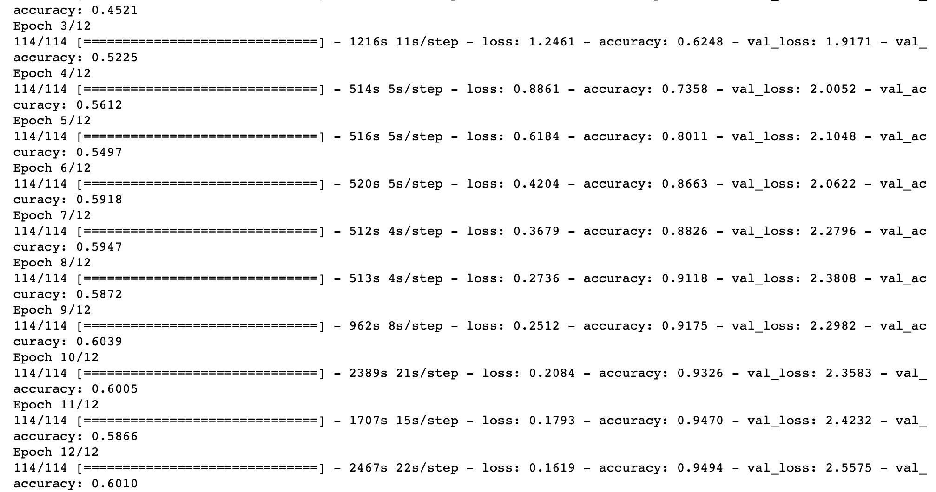
Implementation: training

Slide 17
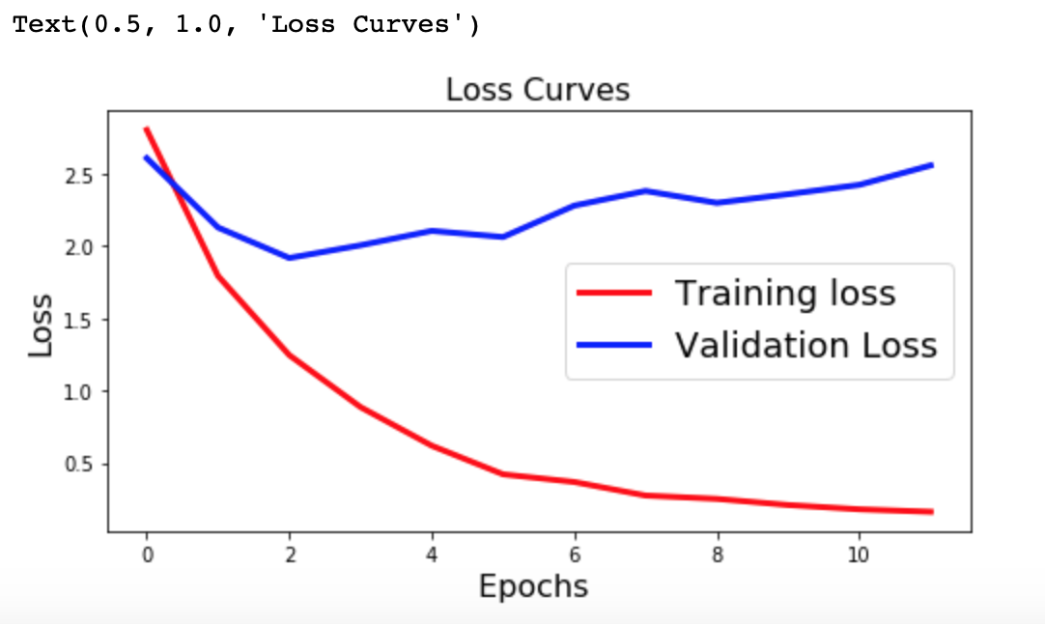
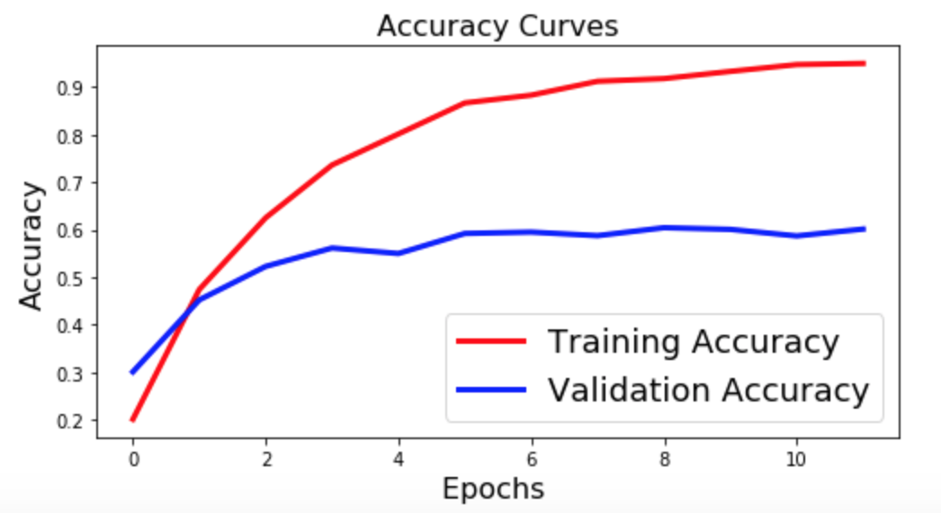
Implementation: Testing

Slide 18
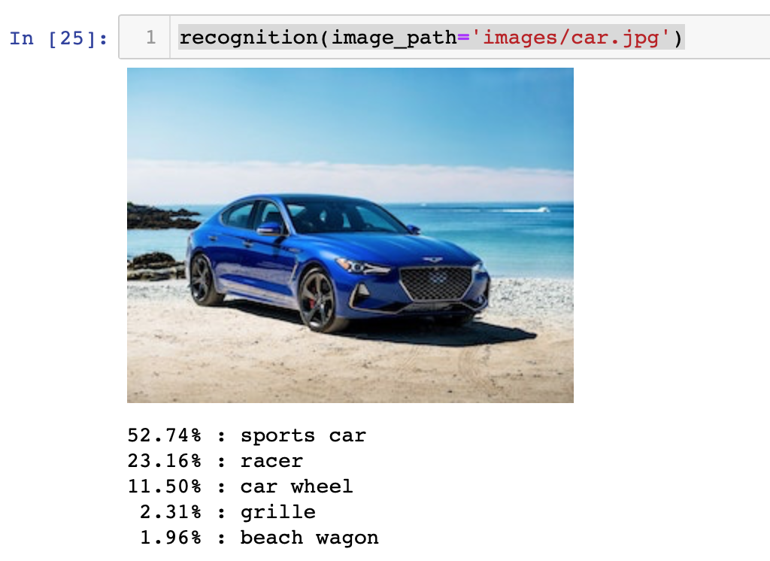
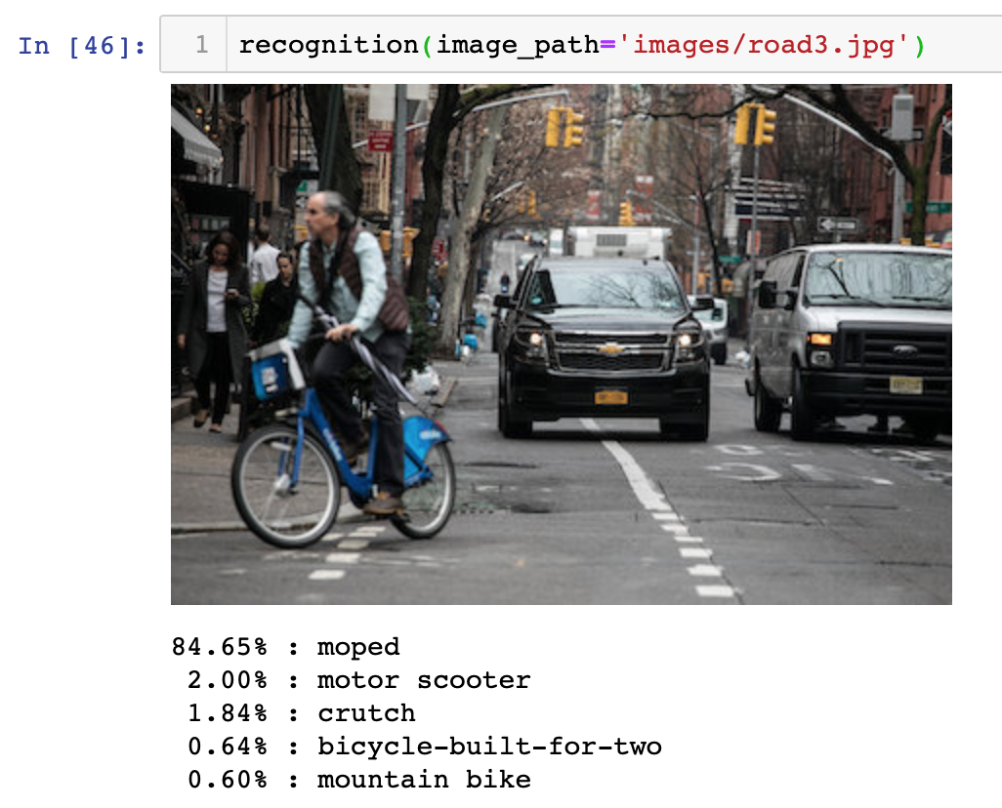
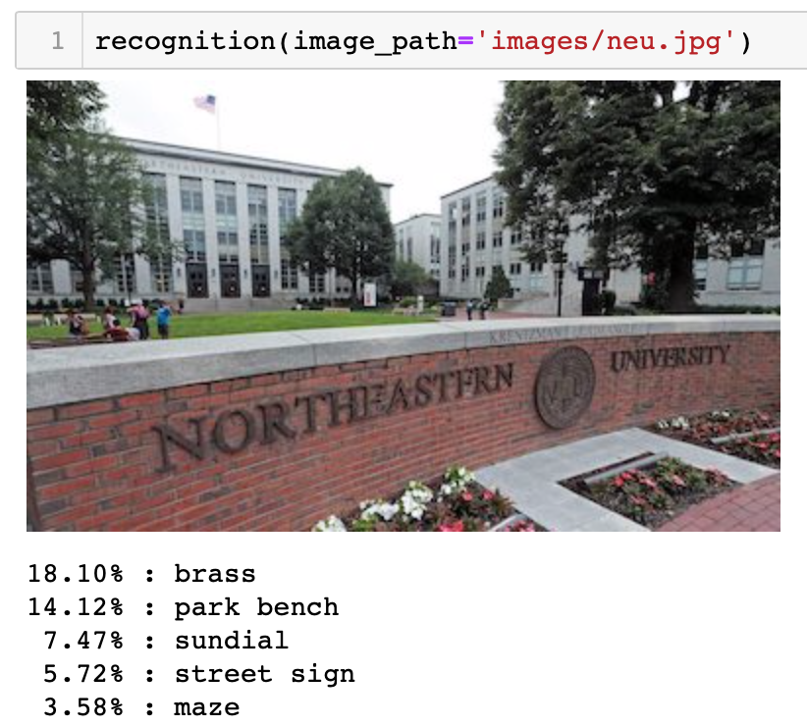
Results

Slide 19
Video

Slide 20
Conclusion
YOLO:
Easier to implement (single stage architecture)
Faster as compared to Mask R-CNN and Inception-v3
Performs well even on cluttered images with occlusion
Mask R-CNN:
Performs object segmentation along with the detection and classification
Slightly higher training time as compared to YOLO
Unable to work well with cluttered and occluded objects
Inception V3:
Works as a single object classifier
Good classification results and moderate training time

Slide 21
Future steps
Integrate the Inception v3 technique along with an object detection model to perform accurately estimate the position of the object along with classification
Try to optimize the models by hyperparameter tuning and increase the testing accuracy.

